Slide 1
Internal Auditors
Training Course on EMS as per ISO 14001:2015
Management Systems Training Welcomes Delegates to this Course
Notes:
Welcome delegates
Organize seating arrangements

Slide 2





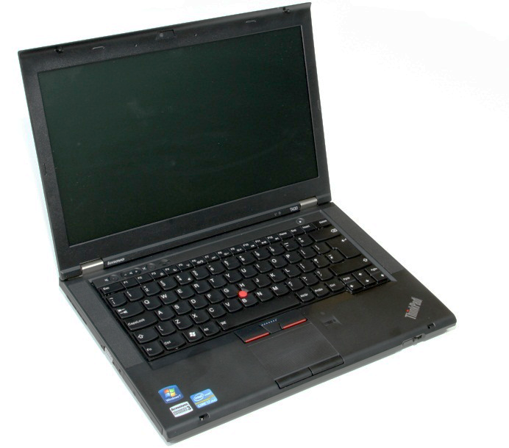
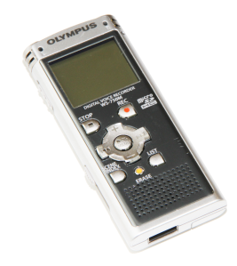
Welcome!
Notes:
For your personal safety, please be aware of the emergency exits from your classroom and the building.
The tutor will inform you of the nearest restrooms.
Please do not leave valuable items unattended in the classroom. Keep them with you, or make other arrangements for their safekeeping.
Please be considerate of other delegates and avoid distractions from the beeping of your mobile telephone.
Please do not use recording devices since they may restrict free discussion.
The tutor will inform you of the lunch and break schedule. Please return to class on time.
The tutor will inform delegates of any area(s) known to be available for smoking.
If there are any special needs (dietary etc.) please inform the tutor now.
…………………………………………………………………………………………………………………………………………………………………………………………………………………………………………………………………………………………………………………………………………………………………………………………………………………………………………………………………………………………………………………………………………………………………………………………………………………………………………………………………………………………

Slide 3
Delegate Introductions
Delegate Introductions
Name
Job role
ISO 14001:2015 understanding (1 to 10)
Understanding of Environment subject (1 to 10)
Course expectations
Notes:
Understanding expectations of delegates is vital to the success of the course – ensure expectations are documented for each delegate and ensure they understand the scope of the course (and that they are not expecting too much, refer to web flyer/JIs if this is the case)
Ask the delegates to introduce themselves, (or each other), the name of their company and it’s product(s). Their system responsibilities within that organization and their knowledge of systems. Finally, what their hobbies or interests are.
The learning point here is that auditors do not rely on memory, but take notes.
Delegates:
name - check spelling for certificate.
company - product or service they provide.
position in the company and experience.
ISO knowledge to help tutors in group selection
1 = Very little knowledge.
3 = Can understand parts of the standard.
7+= Has worked in QA etc..
Hobbies to put delegates at ease

Slide 4
Course Aim
Understanding the working with ISO 14001:2015 system.
Acquiring knowledge and skills to carry out internal audits for the environment management system.
Notes:
Introduce aim of course – content and objectives after

Slide 5
Defining
System - Set of interrelated or interacting elements
Management system – set of interrelated or interacting elements of an organization to establish policies and objectives and processes to achieve those objectives
Environmental management system - part of the management system used to manage environmental aspects, fulfil compliance obligations and address risks and opportunities
Notes:
Bring out the fact that no action takes place without there being some system behind it. Even when we see the routine day to day petty jobs getting done – these happen only because in child hood we learned the system to do these – systems which continue to be valid till date.
System can be defined effective – when it enables achieving. System can be efficient – when it enables achievement with least input.
Parallely, system can be ineffective and inefficient. Some times we may call this – unsystematic.
Defining a system requires defining the arrangements to work with it.

Slide 6

Understanding ISO 14001
What is environment? And what do we mean by an environmental impact?

Slide 7
Inputs, Process and Outputs
Environmental impacts arise from the consumption
of resources and emissions to air, water and land
Smoke
CO₂
CFC
INPUTS
VOC
OUTPUTS
PROCESS
NOX
dB
Products
Materials
Non-hazardous and
hazardous waste
Energy
pH
Oils
BOD
HM
COD
SS
Phenols
⁰C
Solvents

Slide 8
IDENTIFICATION OF ASPECTS/IMPACTS
Example: Inputs and Outputs of a manufacturing process
Raw Materials
Gaseous Emissions
Catalyst
Unit Operation
Water/Air
Products
Energy
By-Products
Recycle
Waste Water
Liquid Wastes
Reusable Waste
Solid Wastes

Slide 9
Approach
We need a systematic approach to identify environmental impacts
Operating
Conditions
Inputs and
Outputs
Environmental
Impacts
Evaluate
Significant
Impacts
Activities
Characterize
and
quantify
Define
Evaluate
Identify

Slide 10
Environmental Issues
Environmental impacts arising from issues can be
categorized as,
Greenhouse effect
Stratospheric ozone depletion
Natural resources
Acid rain
Surface water quality
Bioaccumulation of toxins
Local air quality
Waste burden
External noise
Soil & groundwater contamination
Ecological habitat
Visual intrusion

Slide 11
Environmental Impacts – Sources of Information
Regulatory permit/consent/authorizations and emission limits
Sector application guides
Guidance notes from regulator and industry associations
Environmental impact assessment reports
Toxic release inventories
Material safety data sheets
Stakeholder evaluation surveys
Scientific journals
Insurance company risk assessments
Independent audits/assessments
Environmental site assessments/due diligence studies

Slide 12
Key concepts: Life Cycle
Control
Influence
Atmospheric
Emissions
Servicing
Extraction of
raw
materials
Purchasing
Manufac-
turing
Distribution
Use
Disposal
Design
Recycling
Liquid effluent
Solid waste
Notes:
Definition of life cycle
‘Consecutive and interlinked stages of a product (or service) system, from raw material acquisition or generation from natural resources to final disposal.’
Considering a product or service from a life cycle perspective is to look at the environmental aspects associated with materials and processes at every stage of it’s ‘life’, from extraction of the natural resources through design, production, delivery, and use all the way to eventual recycling or disposal by the end user. This is also referred to as ‘cradle to grave’.
Such an examination does not have to be in depth in order to inform an EMS. Although detailed ‘life cycle analysis’ can reveal potential opportunities for new designs, materials and processes, even when done merely at a high level, it increases understanding of environmental aspects in the supply chain. It also clarifies areas where an organization can directly control matters, where it can exert influence and thus the practical limits (scope) of controls and policies.
This is particularly useful in relation to clause 4.3 of ISO 14001:2015 as there is a requirement to establish the management system scope in relation to the environmental aspects and impacts identified by the organization. As some significant aspects can reside upstream and downstream of an organization, a life cycle perspective helps to understand what the extent of the management system boundary should be.
The term is also used later in the standard (clauses 6.1.2, 8.1) where the requirement is that the life cycle perspective has to be taken into consideration, for example when planning and using operational controls. Purchasing policies may help in selecting more environmentally benign resources upstream, and better information about product or service delivery may help end users make more informed decisions about disposal downstream. Both are areas where an organization can exert influence, and both may turn out to be sources of significant environmental aspects when evaluating activities products and services.

Slide 13
Determining significance of aspects
Business Impact Impacting business image
Complaints, Legal violations and costs involved
Employees’ morale
Loss of potential business
Future impacts Etc.
Env. Impact Impacting humans life, flora or fauna
Impacting
Adversely
Air, water, land or soil
Conditions
Depleting natural resources
Negatively impacting life of future generations
Significance of environmental aspect

Slide 14
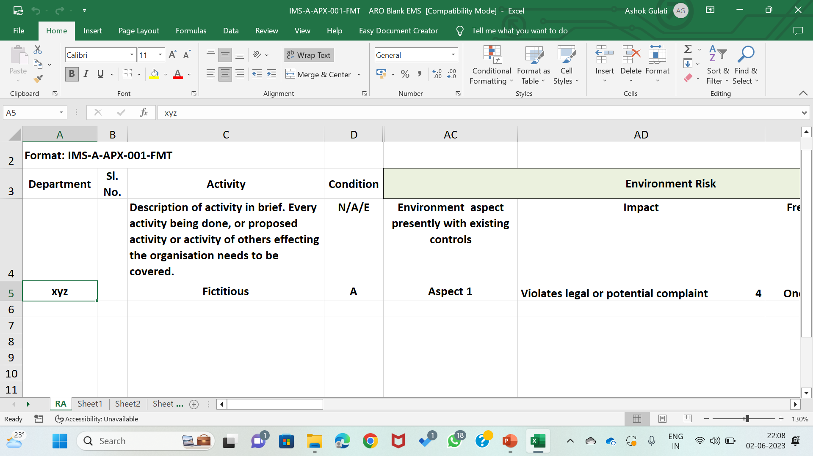
Risks and Opportunities

Slide 15
Hierarchy of Control
elimination or source reduction
reuse or recycling of materials within the process or facility
offsite reuse or recycling of materials
recovery and treatment
controlled disposal

Slide 16
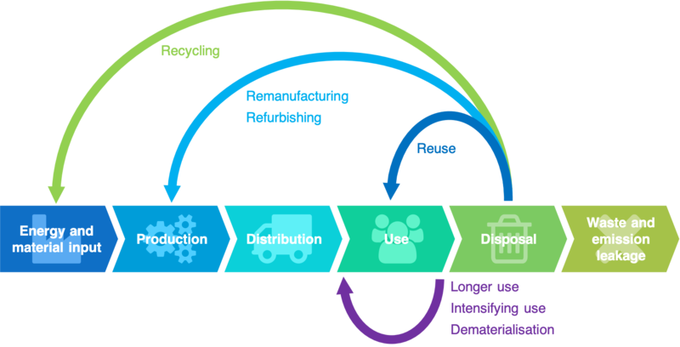
Concept of circular economy

Slide 17
Group Exercise 1
Identify environmental aspects of the department you would be auditing.
30 minutes

Slide 18
ISO 14001:2015
Standard

Slide 19
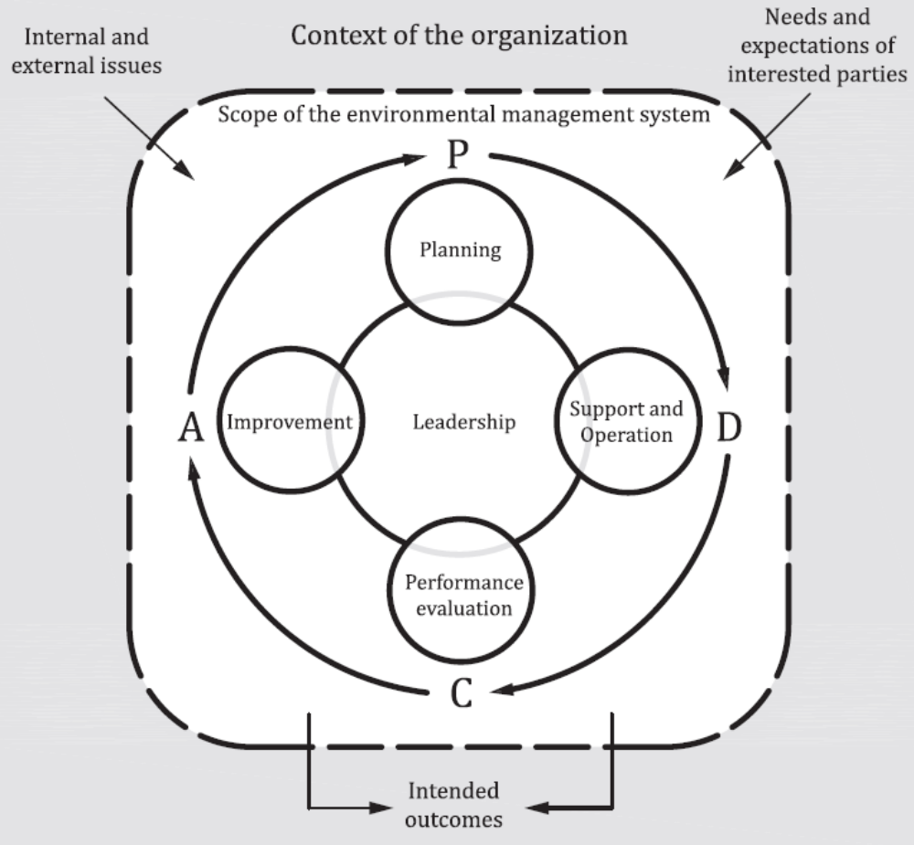

Slide 20
Context of the organization
Environmental conditions – affecting/or being affected
Intended outcomes of the EMS
Purpose
External and internal issues
Unit(s), function(s), boundaries
ORGANIZATION
Activities/Products and services
Interested parties relevant to the EMS
Boundaries and applicability (Scope)
Compliance obligations
Authority/ability to control/influence

Slide 21
External Issues
Metrological conditions
Location and topography
Water availability
Reliability of uninterrupted power supply
Environmental laws
Vintage and technology of the plants
Neighboring industry
Market trends for products and services
Etc.

Slide 22
Internal Issues
Operational control related to environment management
Knowledge and competency of employees
Others – to list

Slide 23
Needs & Expectations of interested Parties on environment
Neighbors
Society at large
Promoters
Different groups of employees
Numerous contractors
Regulators
Shareholders
Financial institutions
Customers
Suppliers
Supply chain business partners

Slide 24
Top management role
Top management shall demonstrate leadership and commitment with respect to the environment management system by:
taking accountability for effectiveness of management system
ensuring that the environment policy and objectives are established and are compatible with the strategic direction and context of the organization;
ensuring that the environment management system achieves its intended outcome(s);

Slide 25
Compliance obligations
ISO 14001:2015 standard requires knowing:
What obligations apply
Reference of obligation and accessing
Why these obligations apply
Risk and opportunities related with it
Does the ems takes into account for implementation of ems
Periodical evaluation

Slide 26
Risk & opportunities for environment aspects from activities
The organization shall determine the risks and opportunities, related to its environmental aspects (reference clause 6.1.2),
to take actions to address its risks and opportunities identified, and
evaluate the effectiveness of these actions

Slide 27
Objectives, Programs ( & KPI)
What are your significant environmental aspects?
What are your compliance obligations?
What are the risks associated with your threats and opportunities?
What are your technological options, financial, operational, and business requirements?
Are the objectives consistent with your environmental policy?

Slide 28
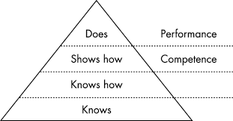
Competence
Ensure that persons are competent for doing work under its control that affects its environmental performance and its ability to fulfil its compliance obligations on the basis of appropriate education, training or experience

Slide 29
Communicating significant aspects
to those assigned responsibility for achieving a related objective;
to those whose work involves a significant environmental aspect.
as required by regulatory authorities;
to relevant interested parties which the organization decides.
Communicate to others as prescribed in the organization’s communication process.

Slide 30
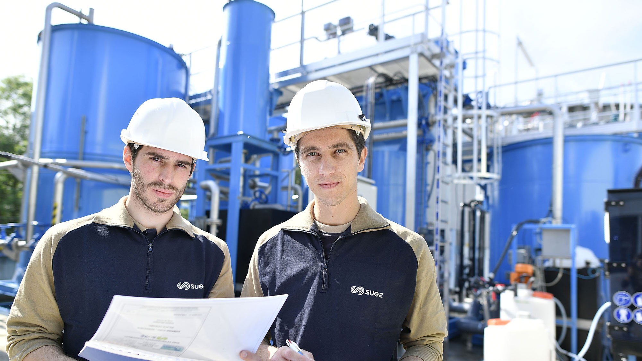
Operations
Establish operating criteria
Implement control as per criteria
Control planned changes
Emergency preparedness

Slide 31
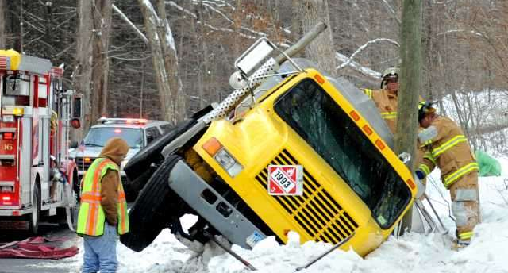
Emergency preparedness and response
Determine what emergency scenarios can happen
Take actions to prevent emergencies
Prepare to respond
To mitigate consequences
Carry out mock drills
Review and revise the
emergency plan
Conduct training and
involve interested parties

Slide 32
Need for documentation
Policy
EMS framework
Processes
Evidence
Support documentation

Slide 33
Monitoring, measurement, analysis and evaluation
Standard requires determining:
what needs to be monitored and measured;
the methods for monitoring, measurement, analysis and evaluation, as applicable, to ensure valid results;
when the monitoring and measuring shall be performed;
when the results from monitoring and measurement shall be analysed and evaluated.

Slide 34
Improvement
Separate clause added to bring focus
The organization shall determine opportunities for improvement and implement necessary actions to achieve the intended outcomes of its environmental management system
The organization shall continually improve the suitability, adequacy and effectiveness of the environmental management system to enhance environmental performance

Slide 35
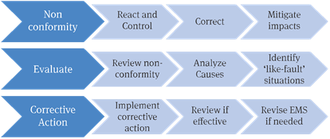
Improvement

Slide 36
The Audit Process: ISO 19011:2018
Notes:
Overview
This module goes through the audit process from start to end
Audit process
Scheduling and planning
Conducting the audit
Reporting the audit
Close-out of findings
Objectives

Slide 37
Definition
Audit
Systematic, independent and documented process
for obtaining audit evidence and evaluating it
objectively to determine the extent to which audit
criteria are fulfilled.
Notes:
Auditing is a management activity and therefore must be planned.
The plan must be implemented in a systematic manner.

Slide 38
Why do we do audit
Purpose of auditing
We can’t audit our own activities
Auditor and auditee have a common goal
Auditor cannot add personally to the requirements
Auditor does not provide solution but aids auditee to discover solution

Slide 39
Find & Compare
What is required to be happening
What is actually happening
Know it before the audit
Get to know during the audit
Fulfillment is compliance
Gaps are the non-conformities

Slide 40
Auditing standard – ISO 19011
ISO 19011 – Guidelines for auditing management systems
The principles of auditing
Guidance on managing audit programmes
Guidance on conducting audits
Guidance on the competence needed by an auditor
Notes:
Introduce 19011.

Slide 41
Principles of auditing
Integrity: the foundation of professionalism
Fair presentation: the obligation to report truthfully and accurately
Due professional care: the application of diligence and judgement in auditing
Confidentiality: security of information
Independence: the basis for the impartiality of the audit and objectivity of the audit conclusions
Evidence-based approach: the rational method for reaching reliable and reproducible audit conclusions in a systematic audit process
Risk based auditing

Slide 42
ISO 19011 Audit Process
6.2 Initiating audit
6.2.1 General (audit Team Leader responsibility)
6.2.2 Establishing contact with auditee
6.2.3 Determining feasibility of audit
6.3 Preparing audit activities
6.3.1 Performing review of documented information
6.3.2 Audit planning
6.3.2.1 Risk-based approach to planning
6.3.2.2 Audit planning details
6.3.3 Assigning work to audit team
6.3.4 Preparing documented information for audit
6.4 Conducting audit activities
6.4.1 General (sequence may be varied)
6.4.2 Assigning roles and responsibilities of guides and observers
6.4.3 Conducting opening meeting
6.4.4 Communicating during audit
6.4.5 Audit information availability and access
6.4.6 Reviewing documented information while conducting audit
6.4.7 Collecting and verifying information
6.4.8 Generating audit findings
6.4.9 Determining audit conclusions
6.4.9.1 Preparation for closing meeting
6.4.9.2 Content of audit conclusions
6.4.10 Conducting closing meeting
6.5 Preparing and distributing audit report
6.5.1 Preparing audit report
6.5.2 Distributing audit report
NOTE:
Subclause numbering refers to the relevant subclauses of this International Standard.
6.6 Completing audit
6.7 Conducting audit follow-up
Notes:
The tutor will direct the class to ISO 19011 Clause 6, and also refer the class to the Terms and definitions for: ‘3.1 Audit’ definition‘.
For clarification:
The tutor will also refer the class to the definition of an ‘audit plan’: By reference to ISO 19011 3.6, and what an ‘audit programme’ is defined as: By reference to ISO 19011 3.4. These will be covered in more depth later in the course, when you will be auditing a supplier’s audit programme. Please note that particular attention always needs to be paid to the design, planning and validation of an audit programme in the case of multiple locations/sites or where important functions are outsourced.
………………………………………………………………………………………………………………………………………………………………………………………………………………………………………………………………………………………………………………………………………………………………………………………………………………………………………………………………………………………………………………………………………………………………………………………………………………………………………………………………………………………………………………………………………………………………………………………………………………………………………………………………………………………………………………………………………………………………………………………………………………………………………………………………………………………………………………………………………………………………………………………………………………………………………………………………………
………………………………………………………………………………………………………………………………………………………………………………………………………………………………………………………………………………………………………………………………………………………………………………………………………………………………………………………………………………………………………………………………………………………………

Slide 43
Audit Process
6.2 Initiating the audit
6.2.1 General (audit Team Leader responsibility)
6.2.2 Establishing contact with auditee
6.2.3 Determining feasibility of audit

Slide 44
Audit Process
6.3 Preparing audit activities
6.3.1 Performing review of documented information
6.3.2 Audit planning
6.3.2.1 Risk-based approach to planning
6.3.2.2 Audit planning details
6.3.3 Assigning work to audit team
6.3.4 Preparing documented information for audit

Slide 45
Audit Process
6.4 Conducting the audit activities
6.4.1 General (sequence may be varied)
6.4.2 Assigning roles and responsibilities of guides and observers
6.4.3 Conducting opening meeting
6.4.4 Communicating during audit
6.4.5 Audit information availability and access
6.4.6 Reviewing documented information while conducting audit
6.4.7 Collecting and verifying information
6.4.8 Generating audit findings
6.4.9 Determining audit conclusions
6.4.9.1 Preparation for closing meeting
6.4.9.2 Content of audit conclusions
6.4.10 Conducting closing meeting

Slide 46
Audit Process
6.5 Preparing and distributing the audit report
6.5.1 Preparing audit report
6.5.2 Distributing audit report

Slide 47
Audit Process
6.6 Completing the audit
6.7 Conducting audit follow-up
(if specified in the audit plan)

Slide 48
Auditing systems
Why do we assess systems?
Effectiveness
Conformance
Understanding
Improvement
Notes:
General discussion.
Ensure the delegates understand what each of the bullet points means.

Slide 49
Types of audits
Internal Audit - on own organisation
First Party
Second Party
Third Party
External
on another eg
supplier
Organisation
Organisation
Third Party -
independent
Notes:
All Management system auditing should be carried out in accordance with ISO 19001.
Internal audits must be carried out by trained auditors who are independent of those having direct responsibility for the activity being audited.
Second party audits are becoming less common as organisations are becoming more confident in the ISO certification process.
Second party auditing must be against defined criteria which need not necessarily be ISO.
Second party auditing is just one method that can be used to evaluate suppliers.
In the UK, not all registration bodies are accredited by UKAS (United Kingdom Accreditation Services). Those who are accredited have to comply with 17021.
Accreditation gives more credibility to the registration body.

Slide 50
P. E. R. C.
Plan
Execute
Report
Close out
Plan
Execute
Report
Close out
Notes:
Introduce the 4 phases of an audit as the PERC acronym.

Slide 51
The Audit Process
Identify requirements
Plan the audit
Identify questions
Ask the questions
Listen to responses
Record findings
Feedback findings
Notes:
Discuss the audit process again as an overview to introduce delegates to the rest of the course

Slide 52
Group Exercise 2
What key personal attributes does an auditor need to conduct an effective audit?
What key personal skills does an auditor need?
What knowledge does an auditor need to assess an IMS?
How could an auditor develop their level of competence?
15 minutes
Notes:
30 minutes in groups, output onto flips – + 30 mins plenary discussion
Tenacious, Decisive, Self-reliant, Ethical, Open-minded, Diplomatic, Observant, Perceptive etc etc (ensure observation is drawn from the discussions as this is used in the next exercise).
Communication, reporting, observation, ‘BS detector’ etc etc
18001, legislation, business requirements, product/process requirements, business processes, DMS, audit procedure etc etc
CPD, training, experience, mentoring etc etc
In feedback from this exercise – introduce delegates to:
Skills
Knowledge
Ability / Attitude
Training
Experience
Groups to be split:
>5 delegates = 1 group, 1 procedure
6 to 10 delegates = 2 groups, 2 procedures
11 to 15 delegates = 3 groups, 2 procedures (1 for one group, 1 for the other two)
16 to 20 delegates = 4 groups, 2 procedures

Slide 53
Auditor Responsibilities
The audit frequency and method, scope and criteria need to be defined
In addition, the following needs to be established
  Auditor competencies
  Requirements for planning audits
  Requirements for conducting audits
  Reporting results and retaining records
Notes:
Ensure delegates understand the need for clearly defined and positive objectives to ensure all involved in the audit understand the importance and purpose.
Criteria needs to be defined to ensure auditors understand the extent of the requirement of the processes being assesses, so they can plan an effective audit.
Scope must be ‘flexible’ to allow associated processes to be assessed as a part of developing audit trails.
Bullet points come from 18001 requirements – ensure delegates are aware of the requirements of 18001 in terms of auditing.

Slide 54
Identifying Requirements
Notes:
Overview
Objectives

Slide 55
Requirements (Criteria)
Requirements come from
  ISO 14001:2015
  Legislations
  Design documents, codes of practices, guidance documents
  Management priority
  Business requirements
  The documented management system
  Product/service/customer requirements
  Other related standards, e.g., IS standards
  Other requirements, e.g., voluntary commitments
  What else ?
Notes:
This list is not exhaustive, draw out further criteria requirements from the delegates, ensure they understand that they are actually covering the ‘management’ of health and safety

Slide 56
Group discussion
Please go through the Internal Audit procedure of your site and discuss with other participants on understanding, agreement or comments if any
20 minutes

Slide 57
Audit Scheduling
Scheduling the audit programme is the responsibility of the person leading the audit process (the program manager)
Audits are required to be scheduled based on
  The results of risk assessments
  The results of previous audits
  Changes in operations/ activities
Notes:
This session should emphasise that audit scheduling is a requirement, and that is should be ‘risk and result’ based. Audit scheduling is covered in more depth on a Lead Auditor course – this is a précis for internal auditors.
There are many types of schedule:
Annual diagonal - very poor practice, unless it is flexible to add in additional audits based on risk and findings
Comprehensive – detailing risk levels and allocating time to the real areas of perceived risk
Forward planned – the audit schedule DOES NOT have to be annual, it can be over a longer period of time.

Slide 58
Audit Planning
From the schedule, audits need to be planned to ensure that they are carried out effectively making efficient use of time
Flexibility should be designed into an audit plan to ensure audit trails can be followed to ensure effective depth of the audit

Slide 59
Audit Planning
When planning audits, the following needs to be considered
  Scope – the departments, processes, activities
  Criteria – the requirements
  Objective – the audit purpose
  Date – and timing of audit areas
  Method – vertical (process), horizontal (theme)
  Competence – auditor experience, skills, knowledge
  Risk – areas of potential concern/high importance
Notes:
Refer to audit plan of Mac Fuels Ltd in delegate workbook for discussion
Method discussed on next slide ….

Slide 60
Audit Method
Vertical Process
Horizontal
Themed
Notes:
Explain vertical and horizontal auditing methods
Vertical = process (upstream and downstream)
Horizontal = themed (possibly against legislation, compliance etc)

Slide 61
Audit Planning
Avoiding problems
  Plan the audit carefully, based on scope and criteria
  Communicate the plan before the audit
  Keep the plan flexible (build in flex)
  Copy in department management
  Ensure importance of audit is understood
  Ensure objective of audit is understood
  Ensure plan is focussed on risk

Slide 62
Internal Audit Plan
Purpose of audit.....................................................................................................................
Date of audit:.........................................................................................................................
Department to be audited......................................................................................................
Name of auditor/s: ...............................................................................................................
Criteria of audit.....................................................................................................................
Prepared by auditor...............................................................................................................
Prepared by :....................................................................................................
Date:......................................................................................................................
Duration (from..to) | Area, Process, Activity to be audited | Comments (sup. To be available) | Name of auditor

Slide 63
Group Exercise 3
Make an audit plan for the department and within allotted time which your group would be auditing
20 minutes

Slide 64
Checklists
The output of the plan is preparation of audit checklists
Checklists are used
  As a memory aid
  For structure
  As a means of recording findings

Slide 65
Checklists
Checklists can be prepared in a variety of styles
  Bullet points
  List of questions
  List of requirements
  Mind maps/spider diagrams
Checklists should form a logical flow as an aid to memory to ensue all important elements are covered during the audit
Notes:
Demonstrate to delegates a couple of different styles of checklist – lists, mind-map etc
Ensure delegate understanding that checklists should be prepared for each individual audit, checklists can be developed from standard templates, but should be related directly to the criteria, scope and objectives.

Slide 66
Group Exercise: 4
Prepare a checklist for an audit of the department you have been asked to audit.
Group 1 Group 3 Group 5 |  | Group 2 Group 4
30 minutes
Notes:
Delegates to group, and identify a topic – prepare a checklist of questions in a logical flow
30 mins in groups

Slide 67
Communicating during Audit
Notes:
Overview
Objectives

Slide 68
The Audit Process
Identify requirements
Plan the audit
Identify questions
Ask the questions
Listen to responses
Record findings
Feedback findings
Notes:
Use slide to show progress through the audit process so far

Slide 69
Communication model
Communication is not simply logical - it is psychological
It is what we do to give and get understanding

Slide 70
Communication Rules
The sender is responsible for accurate communication
It is not important what A says, but what B understands
You cannot not communicate

Slide 71
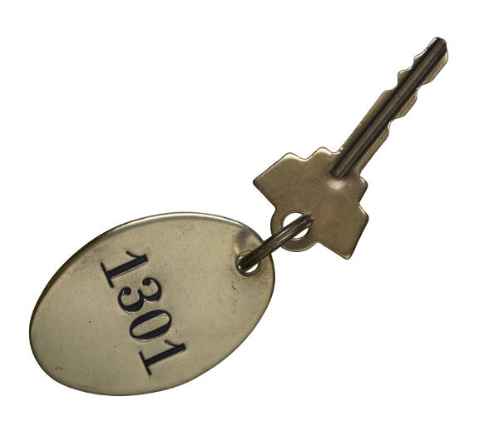
Keys to active listening
Show open body language
……showing you are interested and want to understand
Use paraphrasing
Use commenting words/expressions
Keep eye contact

Slide 72
Listening
Hear – hear the ‘raw’ data
Listen – focus attention on the speaker
Understand – assign a meaning
Evaluate – begin to analyse
Respond – feedback to auditee
Notes:
Hear – hear the ‘raw’ data, all of the words that are being spoken
Listen – focus attention on the speaker, concentrate on all of the speaker’s words
Understand – assign a meaning to the words, assimilate to the topic being discussed
Evaluate – begin to analyze the responses to the criteria (requirements)
Respond – feedback to auditee, parrot back the information to gauge understanding and correctness

Slide 73
Listening
Listen
Understand
Evaluate
Respond
Hear
Notes:
The listening cycle – adapted from work by Terrence A. Doyle, Ph. D, Northern Virginia Community College

Slide 74
What's your body telling you
Body language: The gestures, poses, movements, and expressions that a person uses to communicate.
7 % VERBAL (Conveyed through words)
38 % VOCAL (intonation , pitch, pauses , etc)
55 % NON VERBAL (body language)

Slide 75

Rubbing Hands
Positive
expectation

Slide 76


Closed attitude
&
Open attitude
Closed Attitude Open Attitude

Slide 77


Evaluation
Boredom

Slide 78
Improving the personal effect
A good rapport can be built through reaction and similarity in:
Specific
Situation
Appearance
Posture
Language
Information
Expression
Voice
Gesture
Eye-Contact

Slide 79

Friendly nature
What makes a person most likeable is sincere interest in others.
A warm, genuine smile attracts other to you
Be an open up person. People when they are uncomfortable have a tendency to close off
Use your eyes.
What your body is projecting
Approach others

Slide 80

How to influence positively
Bring awareness
Show an example
Generate imagination of positive results
Encourage in right efforts
Col-laborate

Slide 81

Rapport
A close and harmonious relationship in
which the people or groups concerned understand each other's feelings or ideas and communicate well.
Rapport is a relationship of mutual respect, responsiveness and influence
Its an honest attempt to understand another person from their world
A willingness to be open – it is not agreement
It is possible to have good rapport and strongly disagree

Slide 82
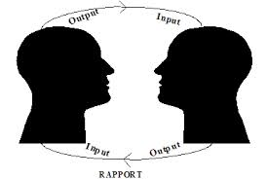
Perceptual Positions
The art of seeing events through the eyes of others
‘the way I see it’
‘If I were you I would’
‘taking into account both views it seems like this'

Slide 83

Overcoming negativeness
Persist in your positive-ness
Be strong in your positive-ness
Assert your positive-ness
Ask the auditee to consider the positive side of logic
Persevere if required
Never give in
You would succeed – partially or fully

Slide 84
Group Exercise 5
Discuss in your group – how one can enhance auditor’s personal attribute of being diplomatic
15 minutes

Slide 85

Questioning – Funnel Approach
OPEN
Gathering
Probing
Verifying
Parroting
CLOSED
Finding
Notes:
Open questioning to start – who, what, where, when, why, how; following the funnel approach to closed questioning – show me
Gathering – open questioning to determine who does what, when done etc
Probing – further developing on gathering to delve a bit deeper
Verifying – to begin to confirm, ask the same question again
Parroting – repeat the information back to the auditee for full confirmation (and take notes)
Finding – confirm compliance or non-compliance

Slide 86
Questioning
Some basic points
  Ask the right person
  Recognize the individual
  Understand why you are asking the question
  Ask simple questions
  Give time to answer
  Don’t be judgemental
Notes:
Ask the right person – identify the right person for the right question
Recognize the individual – understand personal abilities and differences
Understand why you are asking the question – know what you want to achieve from asking the question
Ask simple questions – one question at a time, simple to-the-point language
Give time to answer – don’t hurry for an answer, let the auditee talk (not for too long though)
Don’t be judgemental – don’t ask questions about the person, it is about the process

Slide 87
Questioning – Avoid Problems
Tell the auditee
  What you are going to do
  Why you are there
  What you are asking
  What your findings may be
  And then, what your findings are
Notes:
What you are going to do – outline the audit objectives to ensure that auditees understand the reason and importance of the audit (the opening meeting)
What you are asking – outline the topic area before asking the question, e.g. I am now going to ask about ……..
What you findings may be – positive, improvement need, NC, classify the findings that may go into a report
Why you are there – top management involvement/direction, need to assess conformity, may identify areas to improve/make more efficient/effective
What your findings are – tell the auditee your findings before you leave them do they can confirm/discuss findings (informal closing meeting)

Slide 88
Managing difficult situations
Auditor own HOD does not make him fully free to do job with focused attention
Senior auditee ignore you
Frequent interruptions such that auditee is not available. Time is wasted.
Coordinators only answers all the questions

Slide 89
Managing difficult situations
Activity which you wanted to observe is not happening on the day. Or the person you wanted to meet is not available that day.
Auditor is insulted by group of auditees and coerced to not write certain findings.
Auditees does not accept genuine findings – opposes

Slide 90
Sampling
Sampling is undertaken as we cannot assess every aspect of all activities
Samples are taken from numbers of
  Personnel
  Records, documents
  Plant, equipment
  Areas, locations etc

Slide 91
Sampling
The extent of samples is determined through a process of identifying
  Risk
  Extent
  Importance
  Findings
Notes:
Ensure delegates understand that you cannot assess everything, therefore sampling must be done to determine conformity/nonconformity of the samples taken. Therefore during an audit, NCs may be present but not identified due to sampling.
Sample points and sizes must be determined by:
Risk – level of residual risk within the activities (results of risk assessment), higher risk = greater samples
Extent – the range/pool size to sample from, the higher the pool size, the more samples may be needed
Importance – if the activities are very important to the success of the process/system, increase sample size; less important, reduce
Findings so far – if you identify potential problems, increase the sample size to reflect your perception of the potential level of conformity
Demonstrate sampling though a practical example – for example; equipment maintenance, training records etc. Ask delegates how many they would check, and what criteria they would use for selection, i.e. job numbers, area, plant number, plant usage, risk levels (from risk assessment), accident rates etc etc

Slide 92
Audit Trails
Logical audit trails develop from the responses to initial ‘trigger’ questions
Audit trails are the questions auditors ask to determine
  Conformity
  Effectiveness
  Control
  Competence
Notes:
Ensure at this stage that delegate understand the difference between ‘INSPECTION’ and ‘AUDIT’

Slide 93
One Audit Approach
Identify risks
Look at highest
Objectives to reduce high risks
Risk control measures at site
Performance monitoring
Any incident - investigation
Corrective actions
MRM decisions
Check legal compliance
RRAA, Communication
Records of compliance
Records for improvement
Are all risks identified
Training arising out of it
Any missed
Are the programs reviewed
Effectiveness
Signs of positive leadership

Slide 94
Open Meeting
All audits commence with an opening meeting, either
  Formal or
  Informal
Notes:
Discuss the differences between formal and informal – internal audits more likely to be informal.
All audits start with an opening meeting to set the scene – this should be done with each auditee (briefly) to ensure thy understand the audit process and reason.
Ask delegates to come up with agenda points for both types of open meeting – record on flips

Slide 95
Group Exercise 6
Conducting the audit
120 minutes
Notes:
Delegates to read procedure before breaking for lunch in preparation for questioning after.
Groups to be split:
>5 delegates = 1 group, 1 procedure (time as required)
6 to 10 delegates = 2 groups, 2 procedures (30 mins each or as required)
11 to 15 delegates = 3 groups, 2 procedures (1 for one group, 1 for the other two) (20 mins each)
16 to 20 delegates = 4 groups, 2 procedures (15 mins each)
Ensure delegates understand that when the audit is complete they will need to review the audit schedule as a part of the CHECK and ACT of P.D.C.A.

Slide 96
Audit Findings and Reporting
Notes:
Overview
Objectives

Slide 97
Audit Findings
Audit findings can be classified into four main areas
  Positive – areas working well that could be used as best-practice improvements elsewhere
  Conformity – the process(es) assessed conform(s) to requirements and is effective
  Nonconformity – there is a deviation from a requirement
  Observation – the process(es) is/are conforming but could be improved to become more effective
Notes:
Discuss with delegates that these are the main findings, however they can call them what they like

Slide 98
Nonconformity
A nonconformity should be
CLEAR – No ambiguities
FACTUAL – Based on facts from the audit
ACCURATE – Include the correct information
COMPLETE – Including all identifiers/references
A nonconformity needs two elements
A requirement
A deficiency

Slide 99
Audit Findings
Major
A deviation from requirement(s) resulting in a significant impact on the organisation (potential or actual), or a number of linked minor NCs
Minor
An isolated deviation from requirements(s) not resulting in a significant impact on the organisation
Notes:
The definitions come from BSIs definitions of Major and Minor (adapted) – delegates should understand that they can use these or their own, but they should be classified (in their own procedures) to ensure they focus on the right level of NC and that they can demonstrate why they have identified as Major or Minor to the auditee/management
At this point, delegates are to prepare one (or two) nonconformities from the previous exercise and classify them according to risk. If none were identified, tutor to identify one for them.
Ensure delegates understand that NCs should be:
Foolproof – easy to understand
Accurate – no interpreted information, only the facts
Complete – include all of the identifiers, where, when, what etc
True – a factual representation of the audit finding

Slide 100
Group Exercise 7
Delegate to write NC’s, as identified by them during audit conduct on the NC format
30 minutes

Slide 101
Closing Meeting
As with the opening meeting, the closing meeting can be either informal or formal
Notes:
As with the opening meeting, discuss with delegates the key points for an closing meeting (both formal and informal) and discuss the audience for both types. Also ensure delegate understanding that they should do a ‘mini-closing-meeting’ with all auditees before leaving them.

Slide 102
Reporting
Audit reports should include
  Summary – objective, scope, criteria, overview
  Findings – positive findings, conformity, NC, observations
  Action – summary of agreed actions/action required, including timescales/responsibilities
Notes:
Ensure delegates understand that actions are NOT THIER RESPONSIBILITY but the responsibility of others (management of area, process owner), they can however help with defining actions
An example of an audit report is included in the delegate folder. Review this and answer any questions they may have. Ask delegate to review their own reports (if they are already auditing in their organisations) to see any comparisons/omissions.

Slide 103
Corrective Action Plan (CAP)
Timely and effective action is needed for all nonconformities
Actions should be planned by auditee
Proposed actions should investigate to the root cause and address the same
Auditor should approve CAP
Actions should be implemented by auditee
Action should be evaluated by auditee
Action should be verified by auditor
Notes:
Actions should be assigned to a responsible person – the manager of the department, the process owner etc
Timely and effective action is needed for all nonconformities raised during an audit, timescales need to be determined and agreed with al parties
Proposed actions should investigate the root cause of the problem to prevent recurrence, the 5 whys
Action should be evaluated to ensure it is effective and complete to prevent recurrence, re-audited to ensure effectiveness.

Slide 104
Group Discussion
Why should an internal auditor do a good audit.
15 minutes
Notes:
Delegates to group and review proposed corrective action in the audit report.
NC1 – not bad, a good example of action that should result in an in-depth investigation and effective controls to prevent recurrence
NC2 – bad, no depth, no determination of why the problem occurred, no prevention of recurrence.
NC3 – as NC2

Slide 105

thanks you for your participation
Office: + 91 11 46025992
Mobile: +91 8744944836
DEKRA (India) Pvt Ltd.
New Delhi
Muskaan Complex, Plot 3, B-2, Vasant Kunj, New Delhi – 110070. INDIA
www.dekra.com
Customer Voice: cs.esa@dekra.com
jasdeep.kaur@dekra.com | www.dekra.in

